Slide 1




Transparent Conductive Oxides for Quantum Optical Devices: A Computational Approach
Henry Garland, Madison King, Selena Lamborn and Dr. Stephanie Hurst
BS Student, Department of Chemistry and Biochemistry,
Northern Arizona University, Flagstaff, AZ
2024 Arizona Space Grant Consortium, Tucson, AZ

Slide 2
Outline
Introduction
Python Automated Tauc Plots
DFT Calculations
Interpretation of Results
Conclusion
2

Slide 3
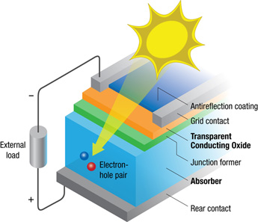
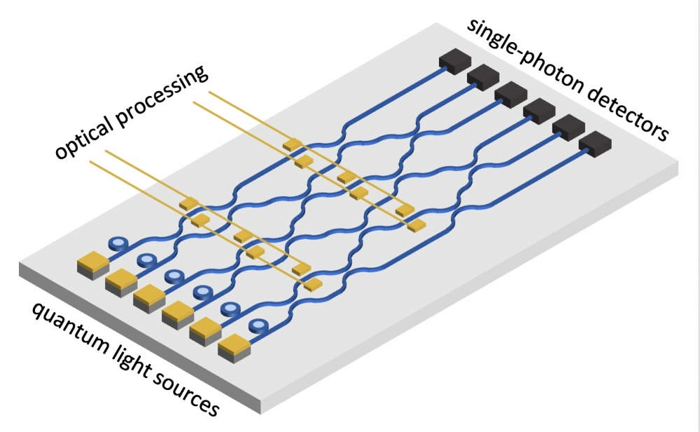
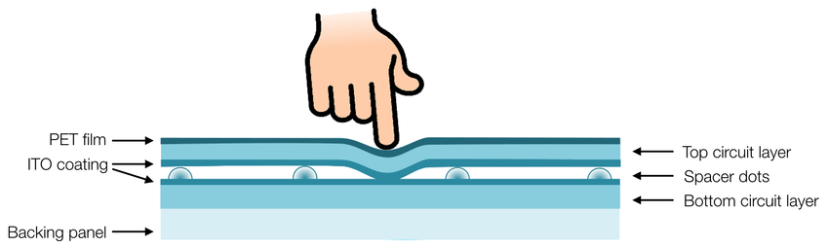
Transparent Conductive Oxides (TCOs)
Conductive materials with low absorption of visible light.
Applications in energy, displays, and quantum optical devices.
Source: nrel.gov
Source: news.ucsb.edu
Source: Vyatskikh A. Master Thesis, 2015, 100 (501), 13140
3

Slide 4
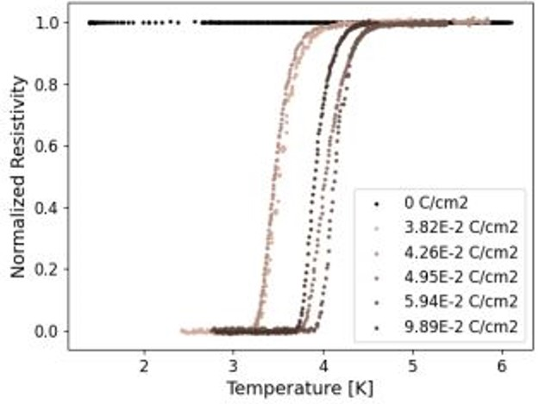
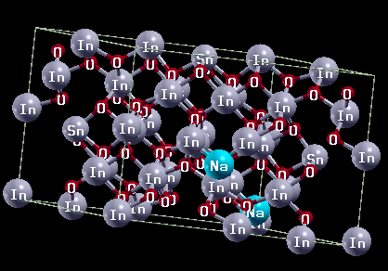
Why Indium Tin Oxide (ITO)?
A very common TCO semiconductor.
Exhibits superconductivity at 2 – 4 K.
Applications in quantum network and communications.
Na⁺ doping introduces more charge carriers, and thus better conductivity in ITO.
Source: A. Aliev et al., Appl. Phys. Lett. 2012, 101 (25), 252603
Source: Garland, H. 2024
4

Slide 5
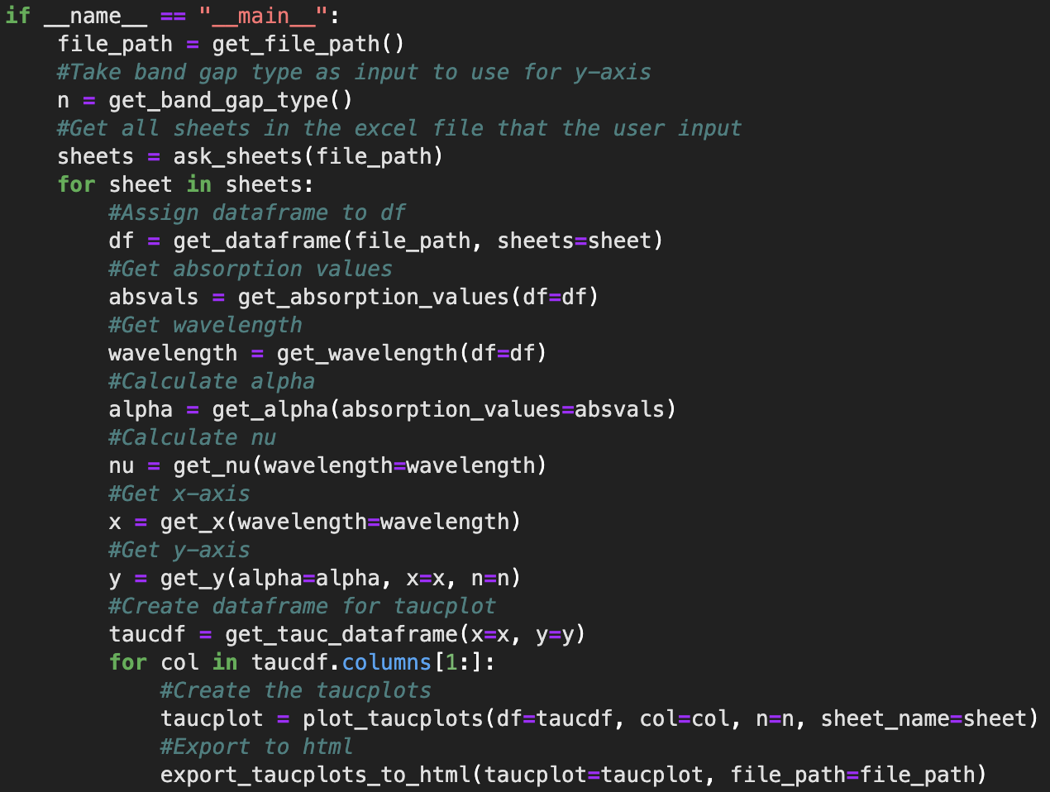
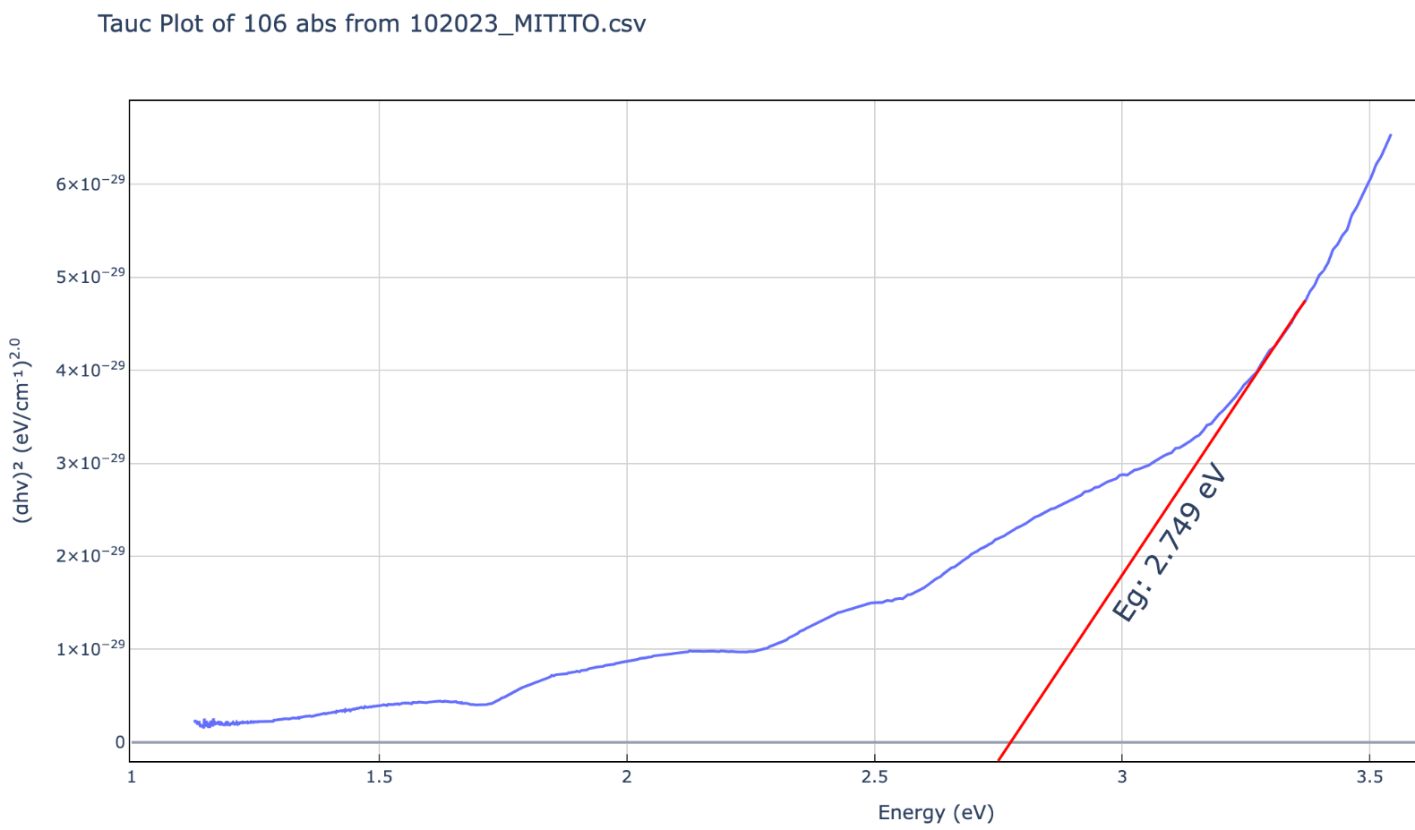
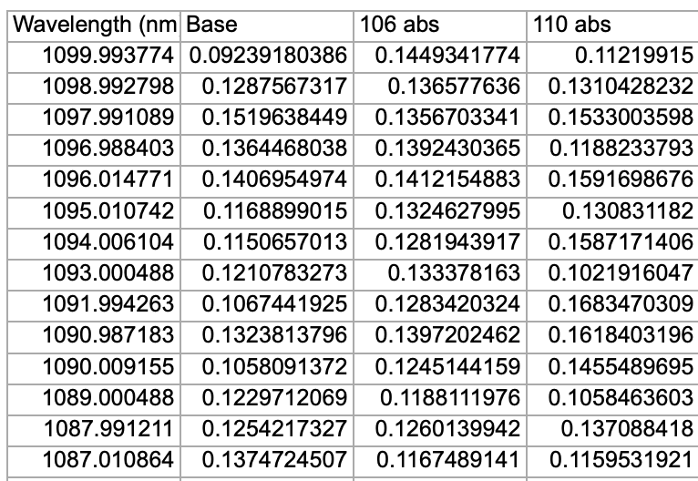
Python Automated Tauc Plots
Provide method for quickly finding the optical band gap of materials from its UV-Visible spectroscopy data.
5

Slide 6
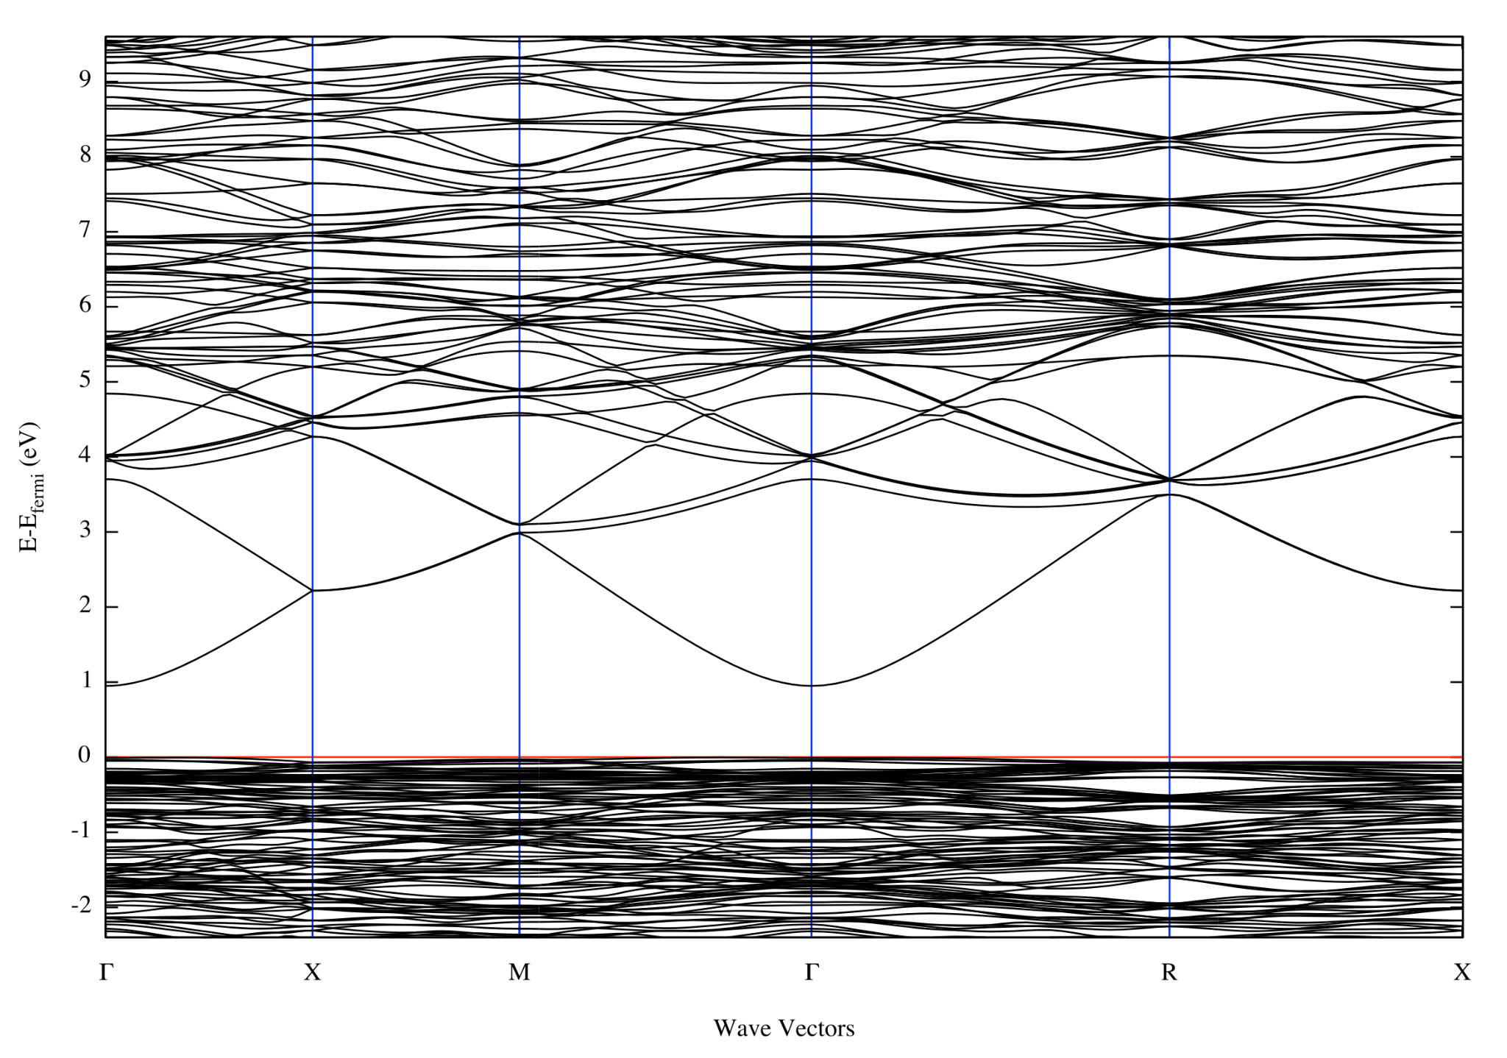
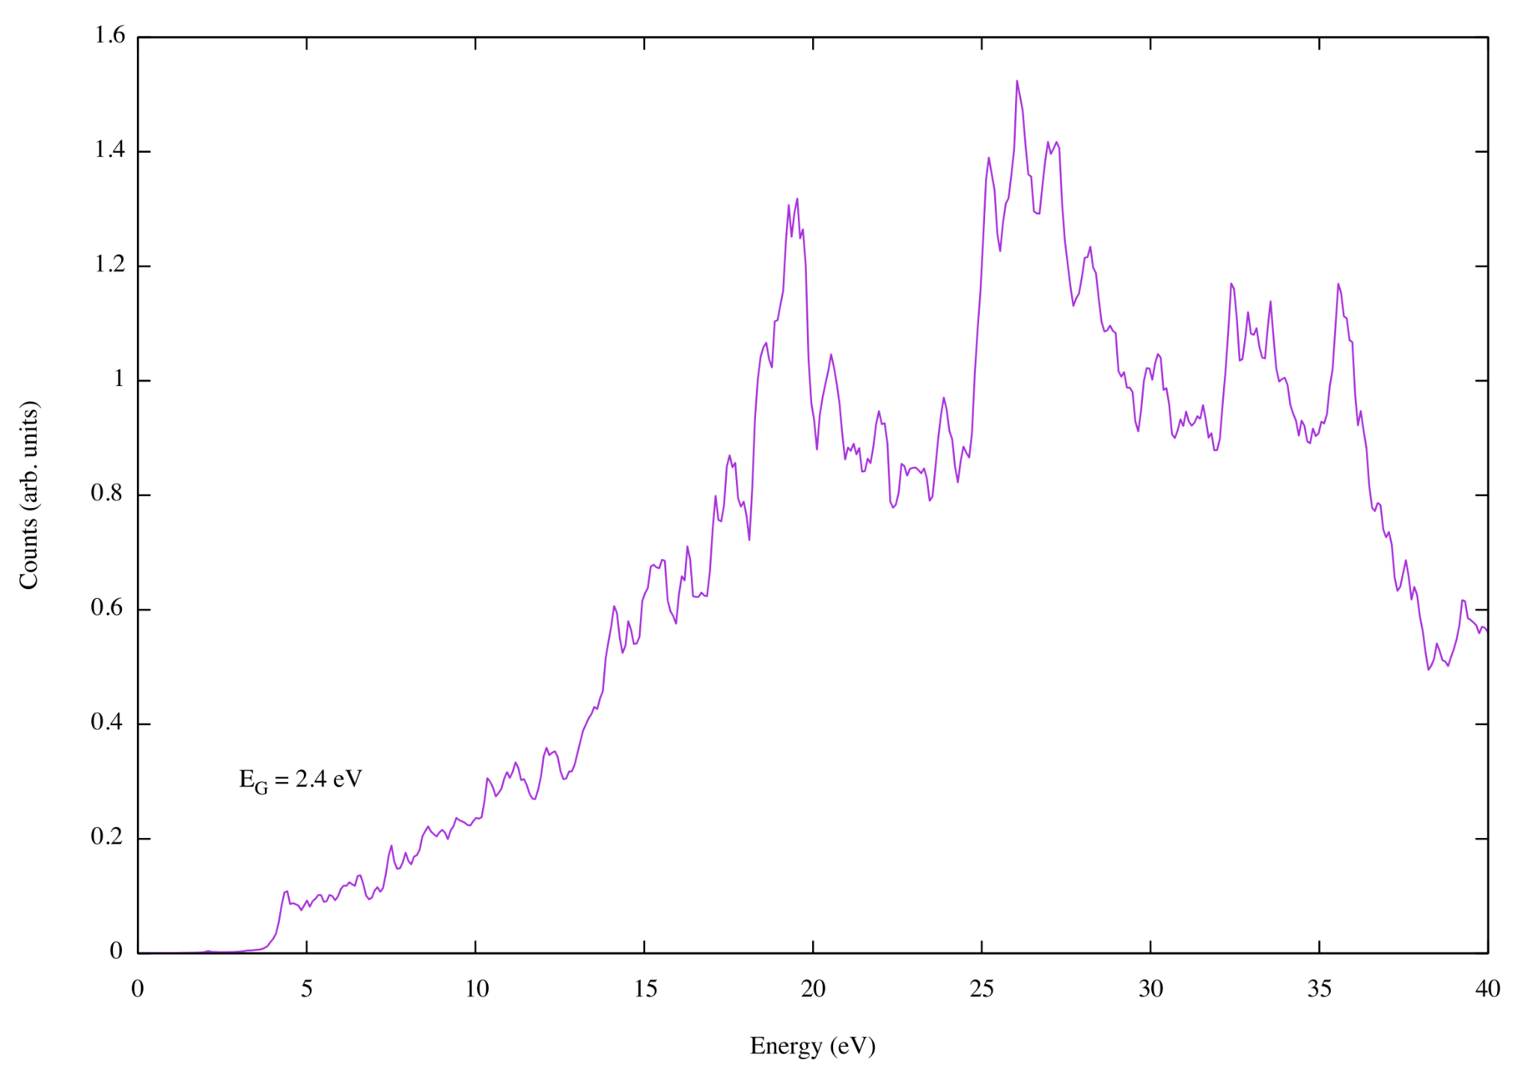
Electronic and Optical Band Gap (BG) with DFT
Band Diagram (pure ITO)
Different energy gap for optical and electronic band gap.
Optical BG > Electronic BG
We want a high optical* and low electronic BG.
*High optical band gap within the range of 3 – 4 eV for visible transparency.
Electron Energy Loss Spectrum (EELS)
E_{G} = ~1 eV
E_{G} = 2.4 eV
EELS Spectrum (pure ITO)
6

Slide 7
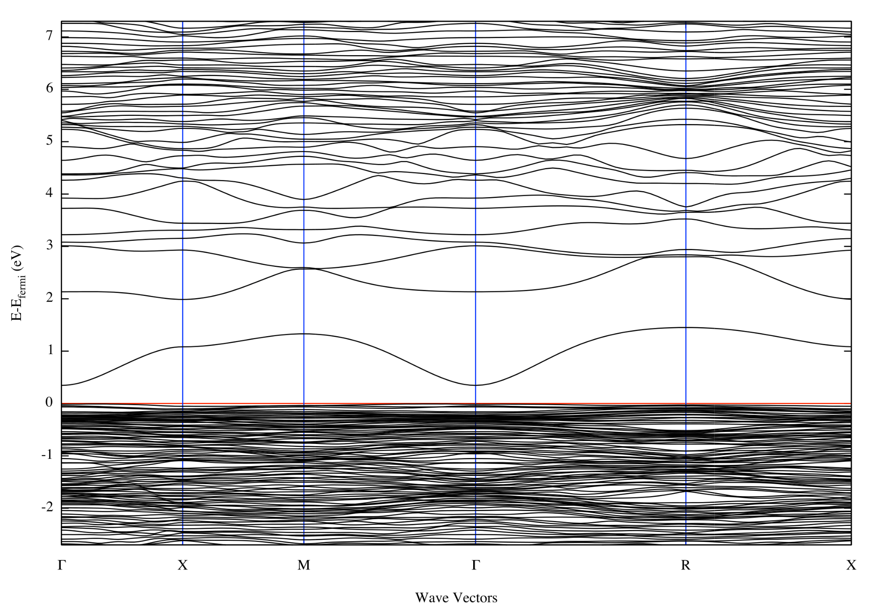
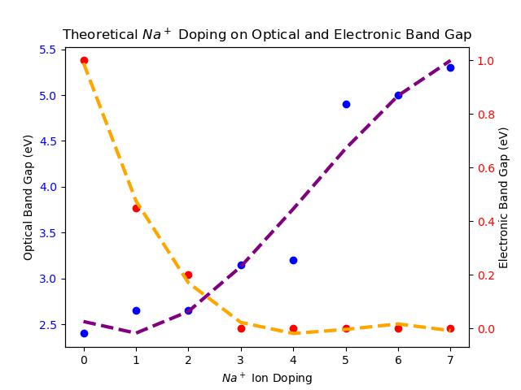
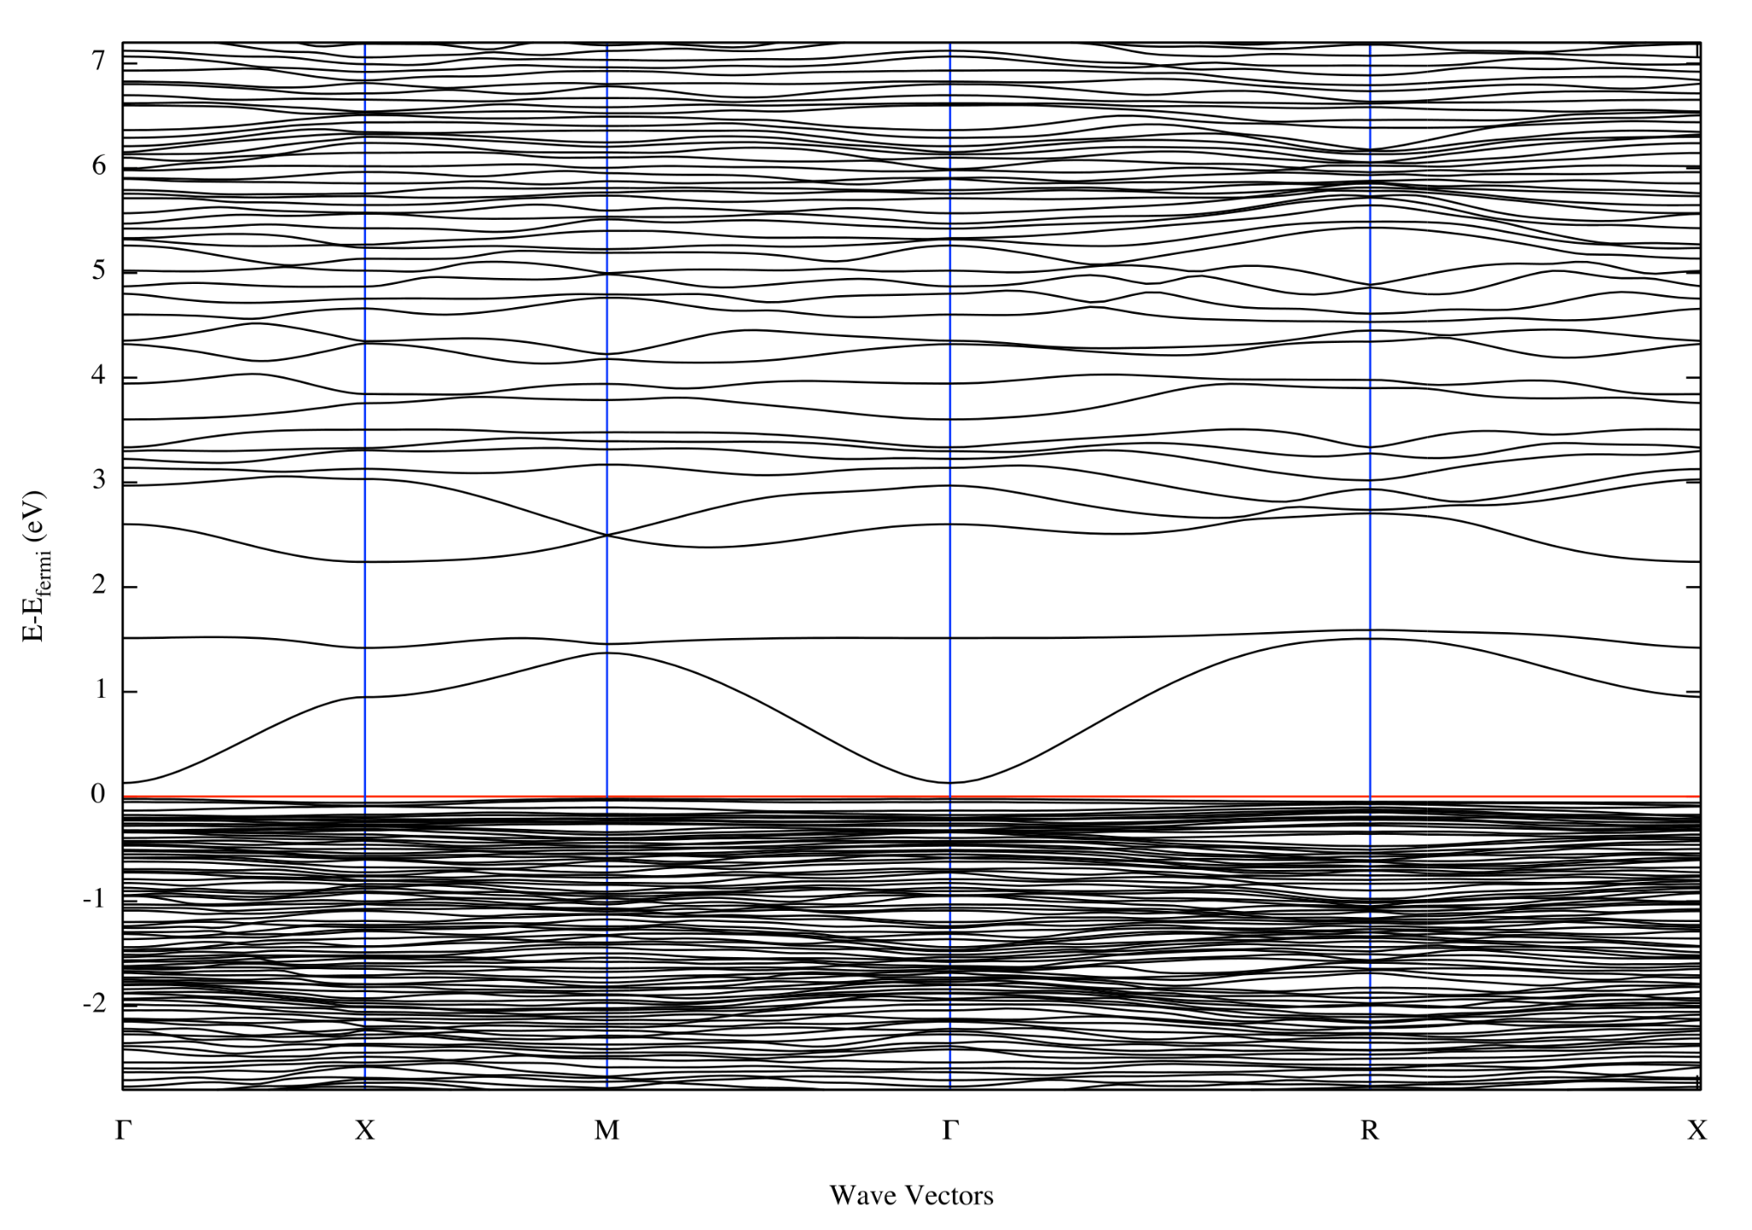
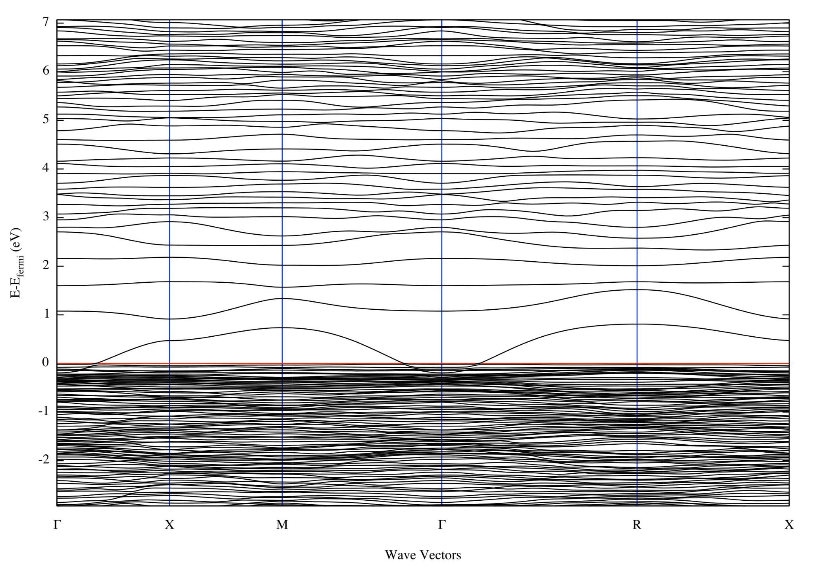
Relationship between Electronic and Optical BG
1 Na⁺-doped ITO ~ 0.45 eV
Shows an inverse relationship.
The electronic BG decreases and the optical BG increases with increased Na⁺ ion doping.
ITO cell optimized when ~2.4 Na⁺ ions are added into ITO unit cell.
2 Na⁺-doped ITO ~ 0.2 eV
3 Na⁺-doped ITO - 0 eV
7

Slide 8
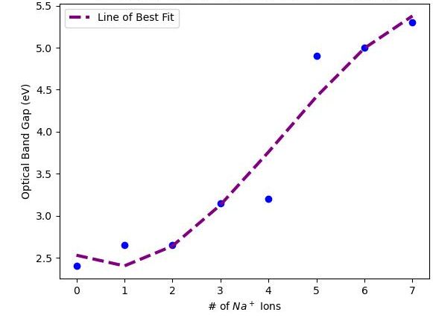
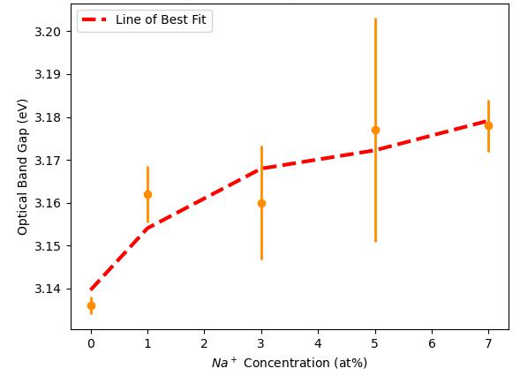
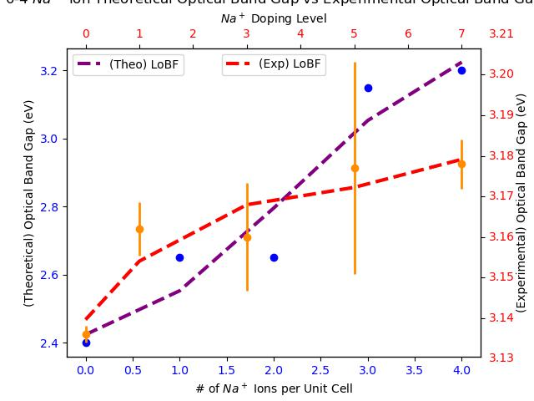
Comparing Theoretical and Experimental Optical BG
DFT does not account for impurities, grain boundaries, or the polycrystalline structure of ITO.
Increased Na⁺ doping = increased optical BG
Particular Na⁺ dopant amounts do not affect the optical band gap significantly.
Theoretical Optical Band Gap vs. Doping Amount
Experimental Optical Band Gap vs. Na⁺ at% Concentrations
0-4 Na⁺ Doping to Experimental Na⁺ Doping Level
8

Slide 9
Conclusion
DFT is a useful tool for electronic structure calculations.
Approximating the optical BG is challenging due to many factors.
The theoretical optical BG calculations do show similar behavior to the experimental optical BG at low levels of theoretical doping.
When compared to the electronic band gap, we are able to find an optimal Na⁺ doping concentration around 3.5-4at%.
9

Slide 10
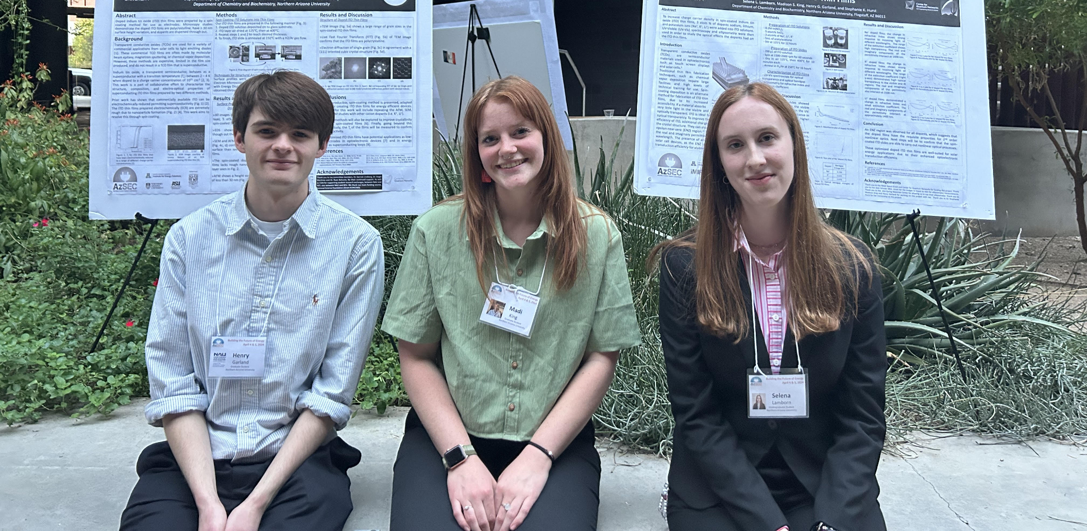


Acknowledgements
Thank you to laboratory partners:
Madison King
Selena Lamborn
Dr. Stephanie Hurst
Facilities:
Monsoon HPC
ASU Eyring Materials Center
Funding sources:
Center for Quantum Networks
Arizona NASA Space Grant
Jean Shuler Mini-grant
10

Slide 11
Thank you

Slide 12
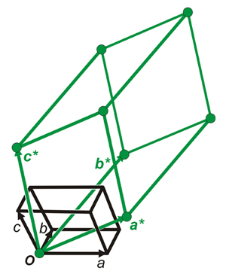
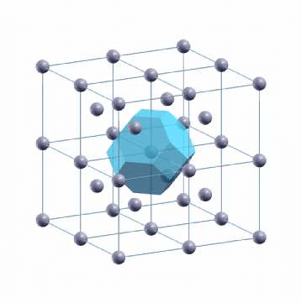
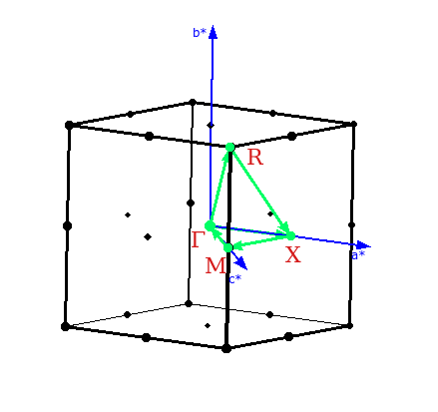
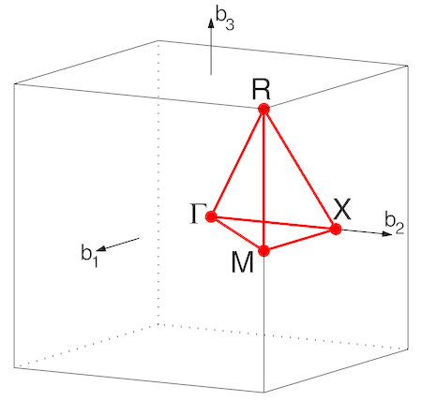
Reciprocal Space and Brillouin Zones
Fourier Transform
Wigner-Seitz Cell
Reciprocal Lattice
Source: N Chamel, P Haensel “Physics of Neutron Star Crusts”
Source: www.xtal.iqf.csic.es
Brillouin Zone
High Symmetry
K-Path
Source: W Setyawan, S Curtarolo “High-throughput electronic band structure calculations: Challenges and tools”

